Slide 1
Exploring Movie Genres and Audience Ratings
SUMMATIVE LAB – SHIRLENE OUMA

Slide 2
EXPLORATORY ANALYSIS · 2010–2019
What movie genres earn the strongest ratings?
IMDb movie genre and audience rating analysis
A preliminary investigation using SQLite, SQL, Pandas and Matplotlib
145,081
73,052
26
movie records in period
rated movies with genres
genre labels observed
Source: supplied IMDb database (im.db). Movies with missing genre or rating excluded from genre comparisons.

Slide 3
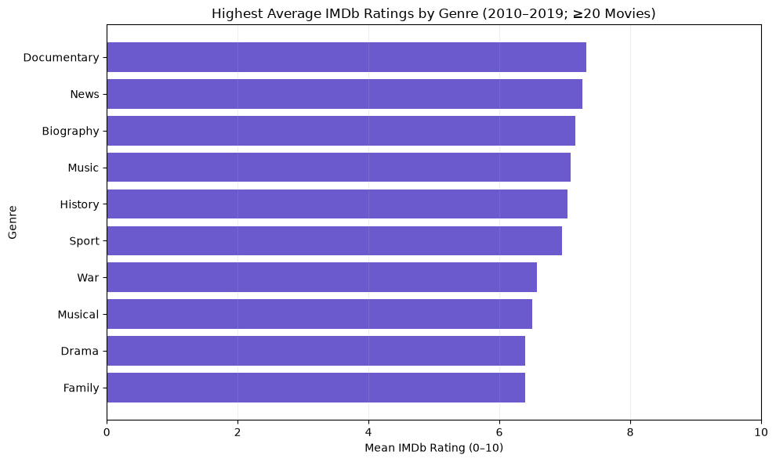
INITIAL EXPLORATION · VISUALIZATION
Genre Ratings: what the data shows
7.33
17,753 films
KEY FINDING
7.27
579 films
Documentary leads eligible genres at 7.33/10.
7.16
3,809 films
7.09
1,968 films
7.04
2,825 films
Drama has the most rated movies (30,788), but a lower mean rating (6.40).
6.96
1,179 films
6.58
853 films
6.50
721 films
Only genres with ≥20 rated films shown. Movies may appear in more than one genre.

Slide 4
IMPLICATIONS · FURTHER INVESTIGATION
The Business Question
Which movie genres consistently receive higher audience ratings, and how do movie counts and audience voting levels affect those comparisons?
WHY IT MATTERS
NEXT ANALYSIS
Ratings can help producers and distributors identify genres worth deeper audience research, but they do not measure profitability.
Compare ratings by genre with movie counts and vote volumes; test whether patterns remain after excluding low-vote titles.

Slide 5
ASSESSMENT ONLY · NOT PERFORMED
Potential Data-cleaning Tasks
01
Missing values
5,359 records lack genres; 30,765 lack runtime. Exclude missing fields relevant to each analysis.
02
Missing ratings
71,225 movies have no matching rating record; do not fill missing ratings.
03
Genre standardization
Split comma-separated genres and check label spelling/whitespace; document overlapping categories.
04
Duplicates and formats
Verify unique movie IDs, joins, release-year and numeric field types.
05
Coverage and reliability
Restrict to 2010–2019; inspect very low vote counts and unusual values.
Cleaning recommendations are identified for future work; no imputation or permanent database changes were made.

Slide 6
THANK YOU!

